Slide 1
Image to Texture
MJ Kim
Sungho Cho

Slide 2
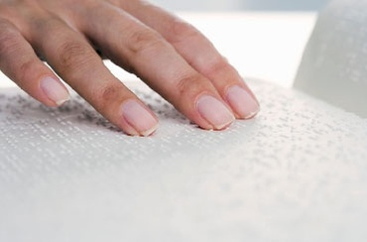
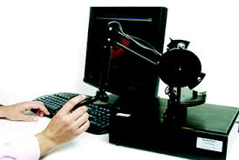
Experimental Goal
Real object surface texture
vs
Virtual surface texture

Slide 3
Experiment : Population Description
Participants 13 participants, 1 female and 12 male average of age is about 25 all are never used haptic device before

Slide 4
Experiment : Hypothesis
Participants will detect the object easily by rendered surface texture.
Rendered surface texture will be similar as real object surface texture.

Slide 5
Experiment : Method
First experiment Without visual information, they only had haptic effect and reckoned object
Second experiment With visual information and haptic effect, they rated haptic effect in range of 1-9(1:never could same, 9:very similar)

Slide 6
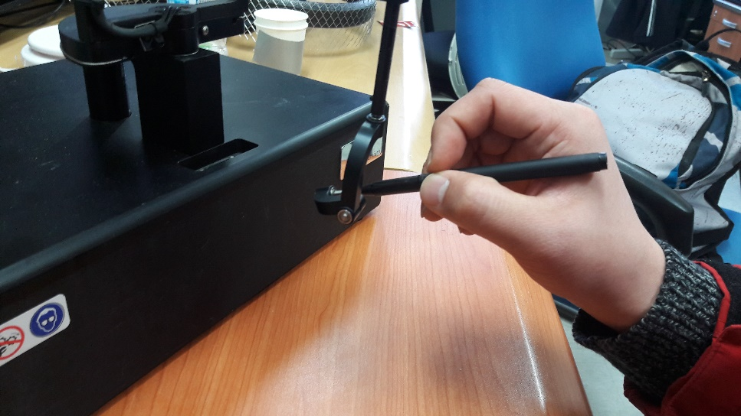
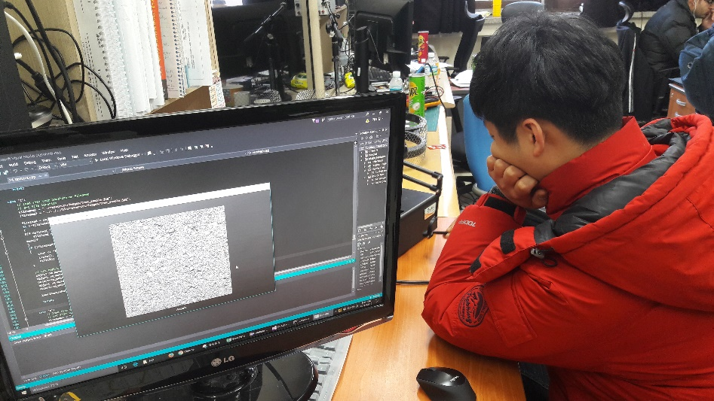
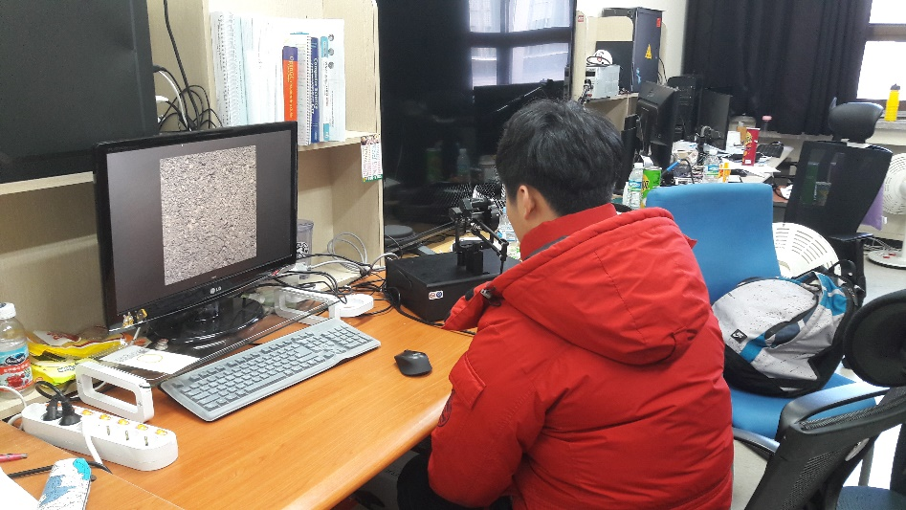
Experiment : Conducting

Slide 7
First Experiment Result
Subject # | Effect | Answer
1 | Asphalt | Stone
2 | Asphalt | Stone
3 | Tree | Marble or Brick
4 | Tree | Slick Stone
5 | Asphalt | Stone or Blackboard
6 | Bread | Eraser
7 | Tree | Tree
8 | Asphalt | Wall or Sandpaper
9 | Tree | Stone
10 | Bread | Balloon
11 | Bread | Latex
12 | Bread | Rubber
13 | Bread | Rubber or Water Balloon

Slide 8
Second Experiment Result

Slide 9

Deep Learning Evaluation
Deep Learning server’s learning rate according to epoch
Deep learning recognition accuracy

Slide 10
Conclusion
Result of bread is especially poor in experiment 1, all of the participants answered elastic object in experiment 2, bread got not-good grade
Experiment error in experiment 1, it was hard to find the position
Deformable vs Rigid rigid objects’ results are more better
Image recognition got 100% during experiment

Slide 11
References
“Heuristic evaluation of virtual reality applications”, A. Sutcliffe, B. Gault

Slide 12
Thank
You!

